Slide 1
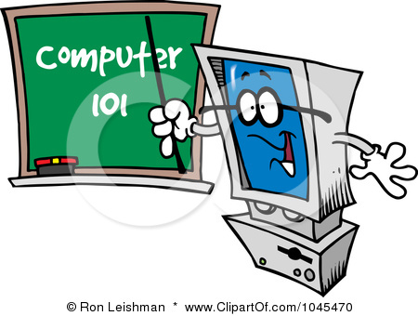
Our Journey to
Computer Literacy
July 31 – Sept. 13, 2018

Slide 2
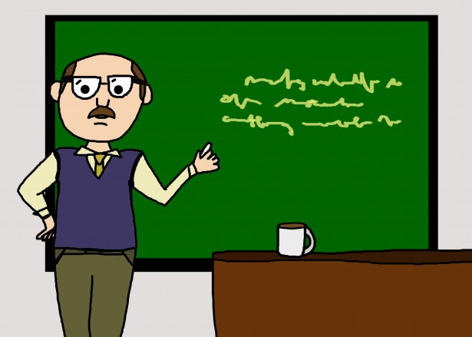
On the first day, we all recognized our instructor, Jim, because he had given us the test before we started the class.

Slide 3
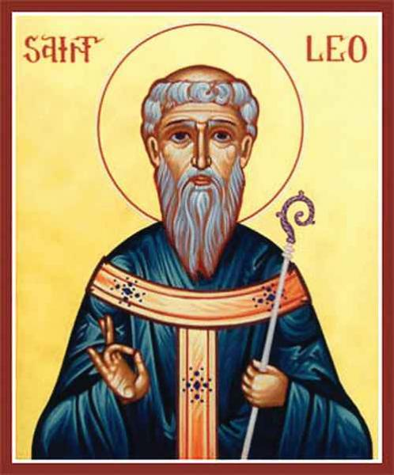
It didn’t take long for us to realize that Jim has the patience of a . . .

Slide 4

He would explain all the ins and outs of the programs and we would ask soooo many questions . . .
How come mine didn’t work?
Can you do that again?
I can’t find the button!
Can you stop by when you get a minute?
Which toolbar do we use?
So it mulitplies and divides first?
This Photo by Unknown Author is licensed under CC BY-SA

Slide 5

But he explained things so well that, before long, we even began to THINK like a computer!

Slide 6
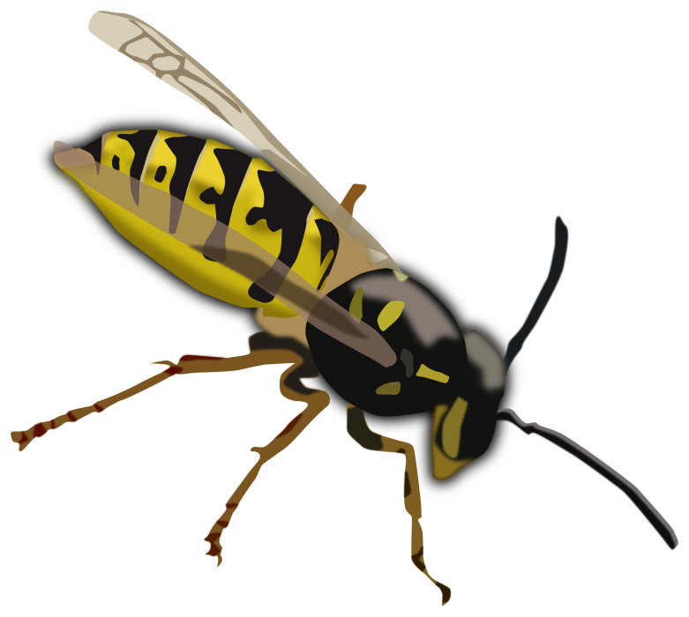
The weeks went by and we learned so much! None of us could believe that 7 weeks went by so quickly. Now THAT is a compliment to our teacher! When, I ask, does time spent learning EXCEL fly by???? He took the STING…
… Right out of it!

Slide 7
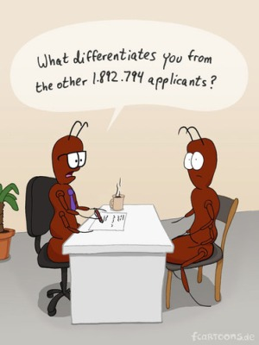
And now, though we are sad that it is time to “graduate,” we are all so thankful that we can say on our resumes that we are PROFICIENT in Word, Excel and PowerPoint!!! We can take the job world head on!
It just so happens I am a graduate of the Jim Pettibone Computer Literacy Class!

Slide 8

So THANK YOU, Jim, for being the Best Computer Instructor ever!
Best Wishes to you!

